Slide 1
EFSA CHANNEL on Youtube
Notes:
Slide 2 for Efsa channel on Youtube

Slide 2
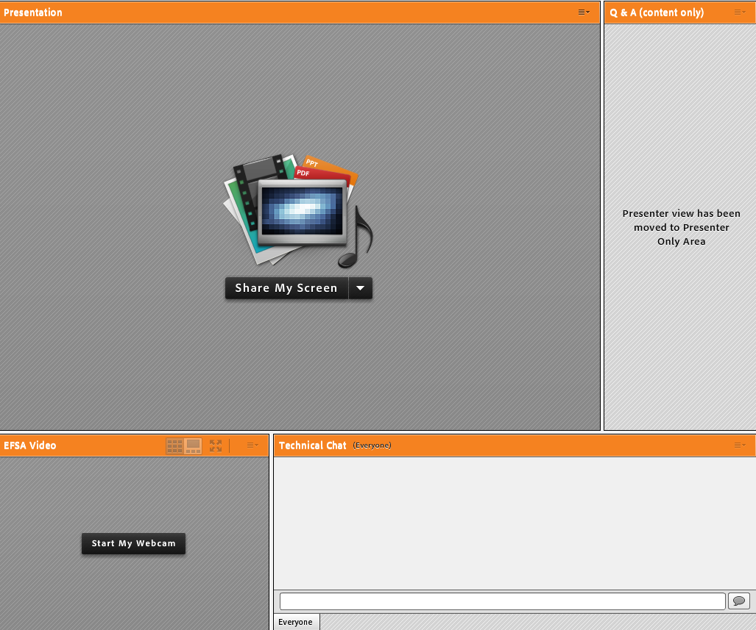
TSE DATA Reporting Tool Webinar - guide to attendees
This webinar is being recorded!
The webinar is in English and questions should be submitted in English
You are automatically connected to the audio broadcast. One-way audio (listen only mode)
Presentation
window
Q&A box: For any questions on the topic of the webinar
Video window

Slide 3
Notes:
1.Slide for the introduction

Slide 4
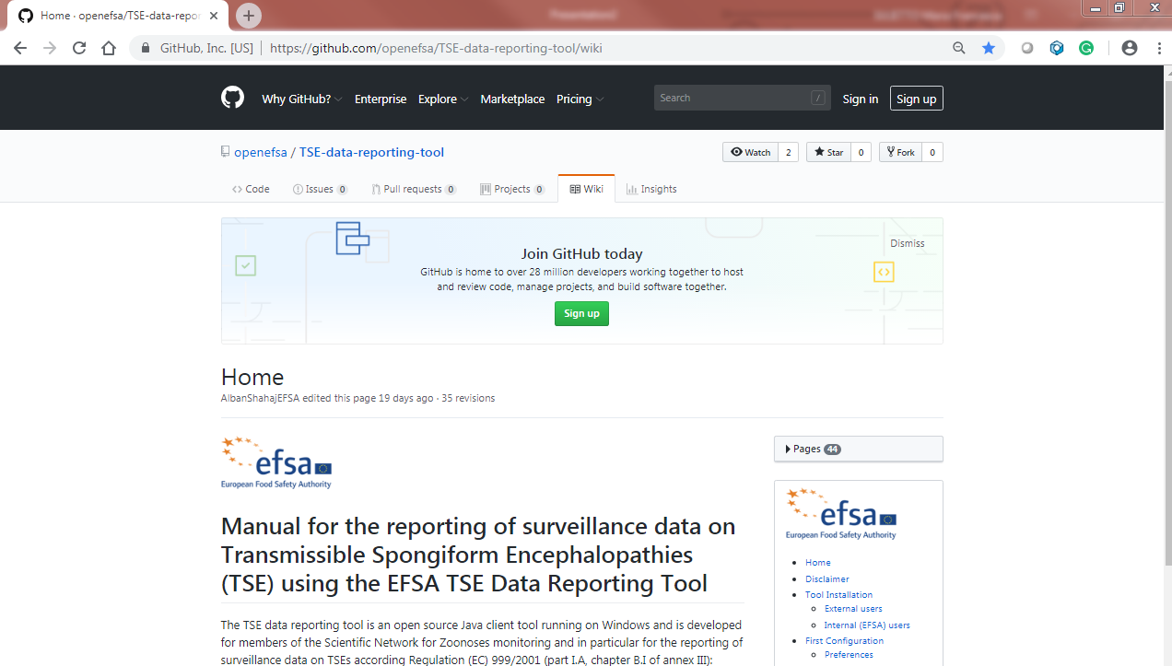
Manual

Slide 5
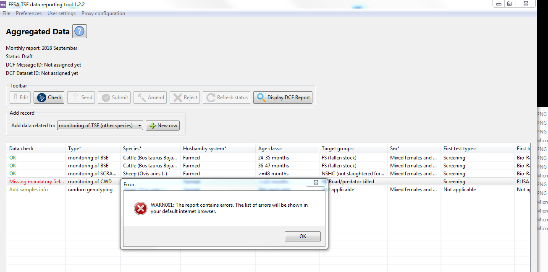
Check

Slide 6
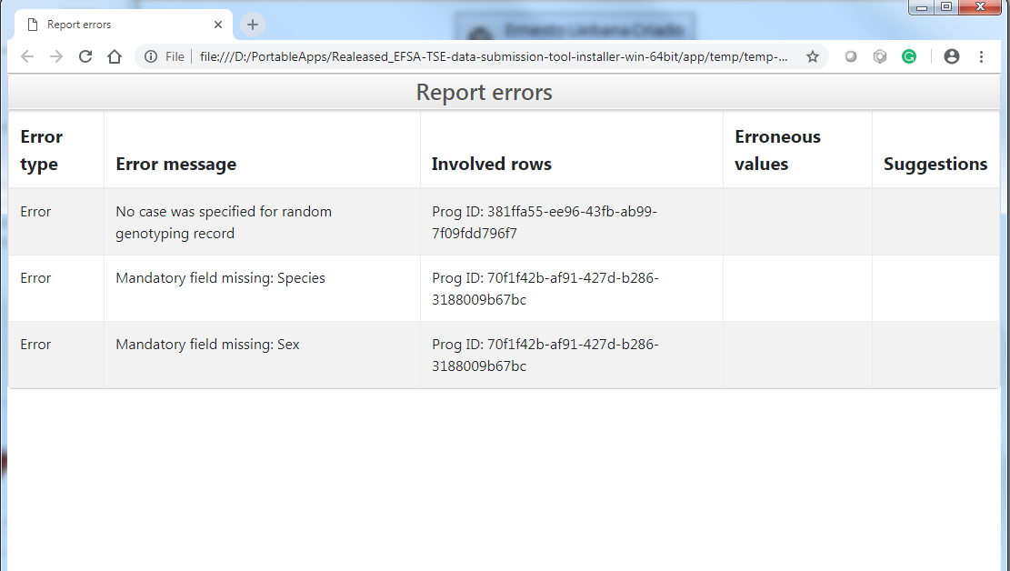
Report with errors

Slide 7
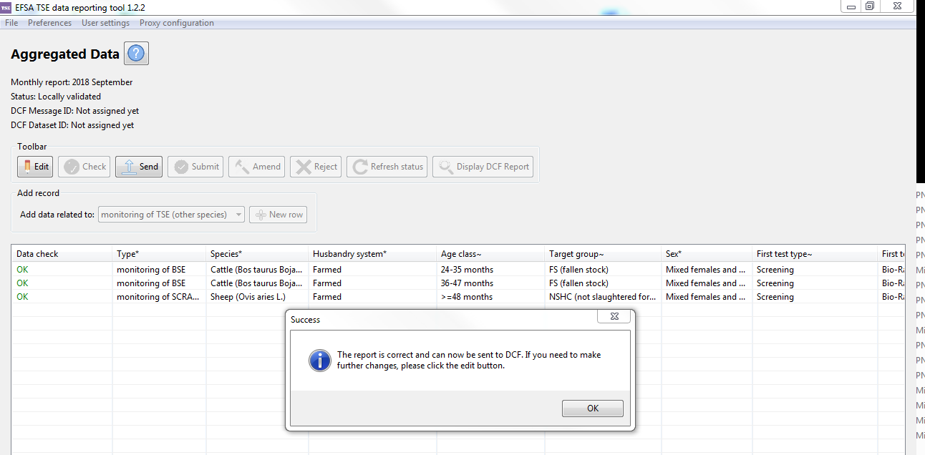
Check

Slide 8
MAIL
From: NoReply@efsa.europa.eu <NoReply@efsa.europa.eu> Sent: 17 December 2018 12:33 To: SURNAME name Subject: Dataset 23353 - LV1703.00 status changed to VALID
Dear user, the following dataset changed its status on 17-12-2018 12:33:04:
Data Collection: TSE.TEST
Fact table: SSD2_CENTRAL_2017
Dataset Id: 23353
Sender dataset Id: LV1703.00
Status: VALID
Organization: EFSA
Data Provider: Name SURNAME
Last modified by: Name SURNAME
Last message Id: 62181
Last filename: report-20181217-121442.xml
Best Regards
From: NoReply@efsa.europa.eu <NoReply@efsa.europa.eu> Sent: 17 December 2018 12:34 To: SURNAME name Subject: Message 62181 - LV1703-20181217-121443 (status: DELIVERED)
Dear user, the following message was uploaded on 17-12-2018 12:14:45
Message Id: 62181
Sender Message Id: LV1703-20181217-121443
Status: DELIVERED
Sender Organization: EFSA
Original filename: report-20181217-121442.xml
User: Name SURNAME
Last modified by: Name SURNAME
The message contains the following payloads:
Operation: INSERT - Status: OK - Dataset: 23353 –
Dataset status: VALID - Data collection: TSE.TEST - Fact table: SSD2_CENTRAL_2017
See attached acknowledge message for details. Best Regards

Slide 9
Submit

Slide 10
Submit

Slide 11
Microstrategy

Slide 12
Accepted DWH

Slide 13
Support
Send an email to
zoonoses_support@efsa.europa.eu

Slide 14
Questions & Answers
Notes:
Image taken from Iconfinder! Is it okay?

Slide 15
Thank you for
attending our webinar!
In case we did not manage to answer all your questions, please feel free to re-submit them via e-mail at:zoonoses_support@efsa.europa.eu
Please take 5 more minutes to fill out the evaluation form that you will receive shortly in your inbox. Your feedback will help us improve our service.

